Slide 1
Data Science Unit 2
Methods for Describing Sets of Data Chapter 2

Slide 2
Learning Objectives
1. Describe Qualitative Data Graphically
2. Describe Numerical Data Graphically
3. Create & Interpret Graphical Displays
4. Explain Numerical Data Properties
5. Describe Summary Measures
6. Analyze Numerical Data Using Summary Measures

Slide 3
Thinking Challenge
Our market share far exceeds all competitors! - VP
X
Y
Us
30%
32%
34%
36%
Notes:
Problem - no zero point. Maybe, a pie chart would be better.

Slide 4
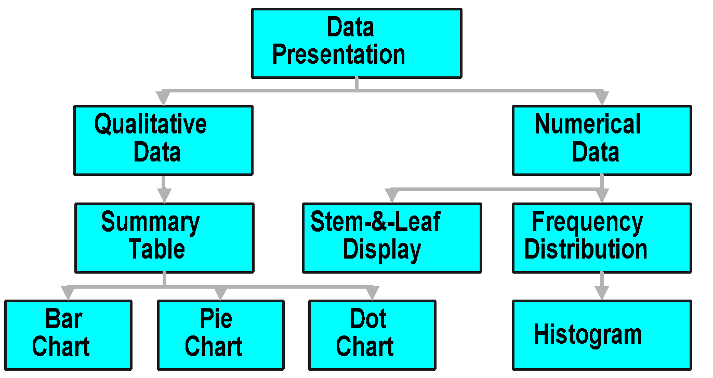
Data Presentation

Slide 5
Presenting Qualitative Data

Slide 6
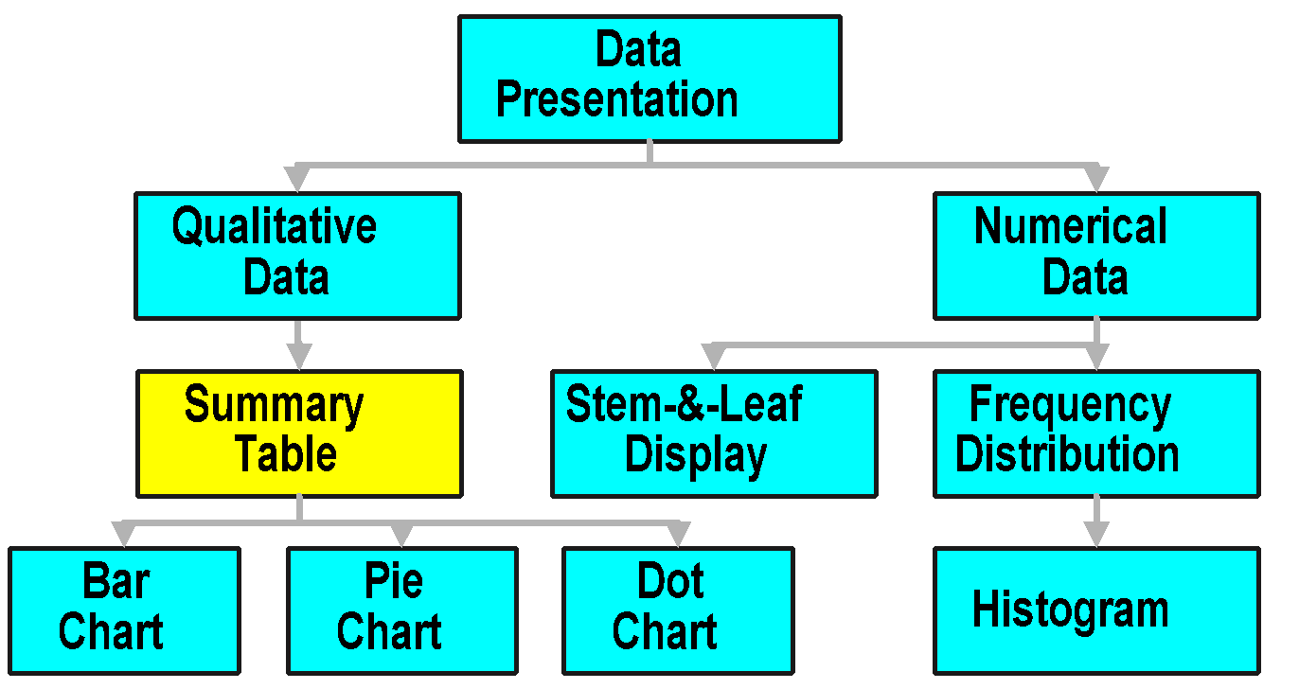
Data Presentation

Slide 7
Summary Table
1. Lists Categories & No. Elements in Category
2. Obtained by Tallying Responses in Category
3. May Show Frequencies (Counts), % or Both
Row Is Category
Major
Count
Tally: |||| |||| |||| ||||
Accounting
130
Economics
20
Management
50
Total
200

Slide 8
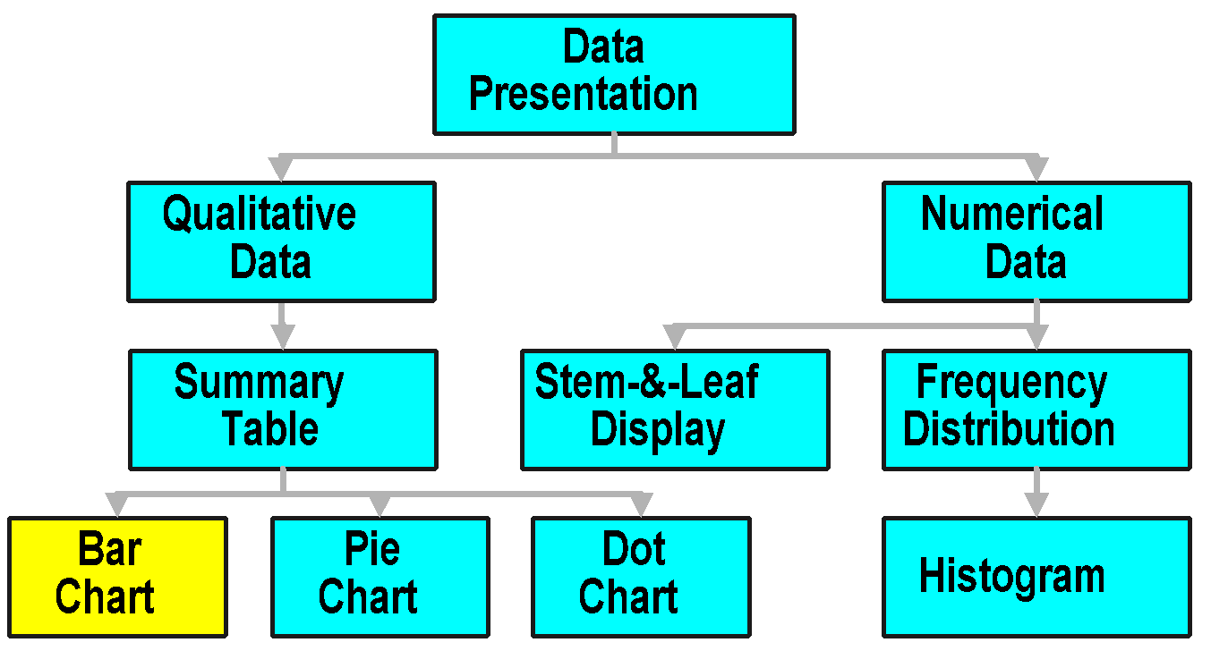
Data Presentation

Slide 9
Bar Chart
Horizontal Bars for Categorical Variables
Major
Bar Length Shows Frequency or %
Mgmt.
Equal Bar Widths
Econ.
1/2 to 1 Bar Width
Acct.
Zero Point
0
50
100
150
Percent Used Also
Frequency
Notes:
Horizontal bars are used for categorical variables.
Vertical bars are used for numerical variables.
Still, some variation exists on this point in the literature.
Also, there are many variations on the bar (e.g., stacked bar)

Slide 10
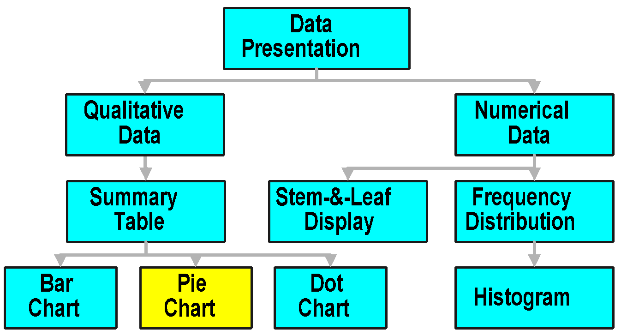
Data Presentation

Slide 11
Pie Chart
1. Shows Breakdown of Total Quantity into Categories
2. Useful for Showing Relative Differences
3. Angle Size
(360°)(Percent)
Majors
Mgmt.
Econ.
25%
10%
36°
Acct.
65%
(360°) (10%) = 36°

Slide 12
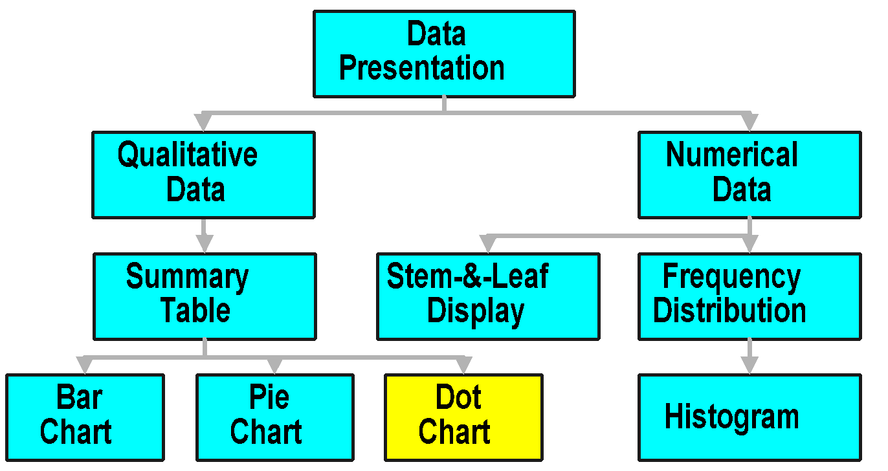
Data Presentation

Slide 13
Dot Chart
Like Horizontal Bar Chart
Major
Line Length Shows Frequency or %
Mgmt.
Horizontal Lines for Categorical Variables
Equal Spacing
Econ.
Acct.
Zero Point
0
50
100
150
Percent Used Also
Frequency

Slide 14
Graphical Excellence
1. Greatest Number of Ideas
2. Shortest Time to Understand
3. Least ‘Ink’ (Fill & Lines)
4. Smallest Space
Dot Chart
Bar Chart
Pie Chart

Slide 15

Thinking Challenge
You’re an analyst for IRI. You want to show the market shares held by Windows program manufacturers in 1992. Construct a bar chart, pie chart, & dot chart to describe the data.
Mfg. Mkt. Share (%)
Lotus 15
Microsoft 60
WordPerfect 10
Others 15
Notes:
Allow students 10-15 minutes to complete this before revealing answers.

Slide 16
Bar Chart Solution*
Mfg.
Lotus
Microsoft
Wordperf.
Others
0%
20%
40%
60%
Market Share (%)

Slide 17
Pie Chart Solution*
Market Share
Others
Wordperf.
15%
10%
Lotus
15%
Microsoft
60%

Slide 18
Dot Chart Solution*
Mfg.
Lotus
Microsoft
Wordperf.
Others
0%
20%
40%
60%
Market Share (%)

Slide 19
Presenting Numerical Data

Slide 20
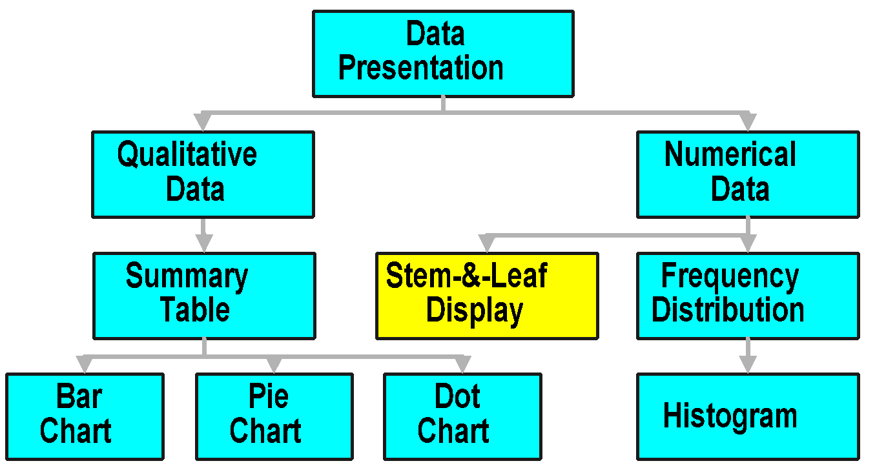
Data Presentation

Slide 21

Stem-and-Leaf Display
1. Divide Each Observation into Stem Value and Leaf Value
Stem Value Defines Class
Leaf Value Defines Frequency (Count)
26
2. Data: 21, 24, 24, 26, 27, 27, 30, 32, 38, 41

Slide 22
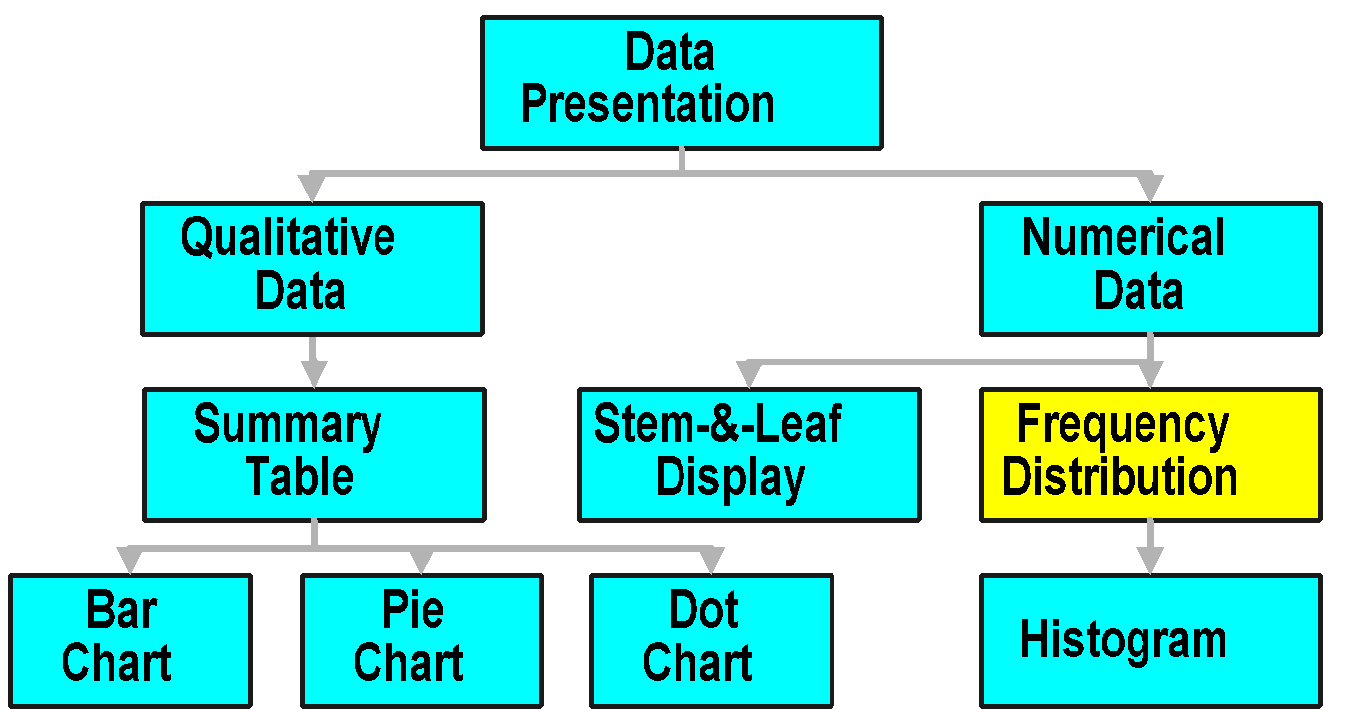
Data Presentation

Slide 23
Frequency Distribution Table
Raw Data: 24, 26, 24, 21, 27, 27, 30, 41, 32, 38
Class
Frequency
15 but < 25
3
25 but < 35
5
35 but < 45
2
Notes:
The number of classes is usually between 5 and 15. Only 3 are used here for illustration purposes.

Slide 24
Frequency Distribution Table Steps
1. Determine Range
2. Select Number of Classes
Usually Between 5 & 15 Inclusive
3. Compute Class Intervals (Width)
4. Determine Class Boundaries (Limits)
5. Compute Class Midpoints
6. Count Observations & Assign to Classes

Slide 25

Frequency Distribution Table Example
Raw Data: 24, 26, 24, 21, 27, 27, 30, 41, 32, 38
Class
Midpoint
Frequency
15 but < 25
20
3
Width
25 but < 35
30
5
35 but < 45
40
2
(Upper + Lower Boundaries) / 2
Boundaries

Slide 26
Relative Frequency & % Distribution Tables
Relative Frequency Distribution
Percentage Distribution
Class
Prop.
Class
%
15 but < 25
.3
15 but < 25
30.0
25 but < 35
.5
25 but < 35
50.0
35 but < 45
.2
35 but < 45
20.0
Notes:
The number of classes is usually between 5 and 15. Only 3 are used here for illustration purposes.

Slide 27
Cumulative Percentage Distribution Table
Raw Data: 24, 26, 24, 21, 27, 27, 30, 41, 32, 38
Percentage Less than Lower Class Boundary
Class
Cumulative
Percentage
15 but < 25
0.0
Lower Class Boundary
25 but < 35
30.0
35 but < 45
80.0
30% + 50%
45 but < 55
100.0
80% + 20%
Notes:
The number of classes is usually between 5 and 15. Only 3 are used here for illustration purposes.

Slide 28
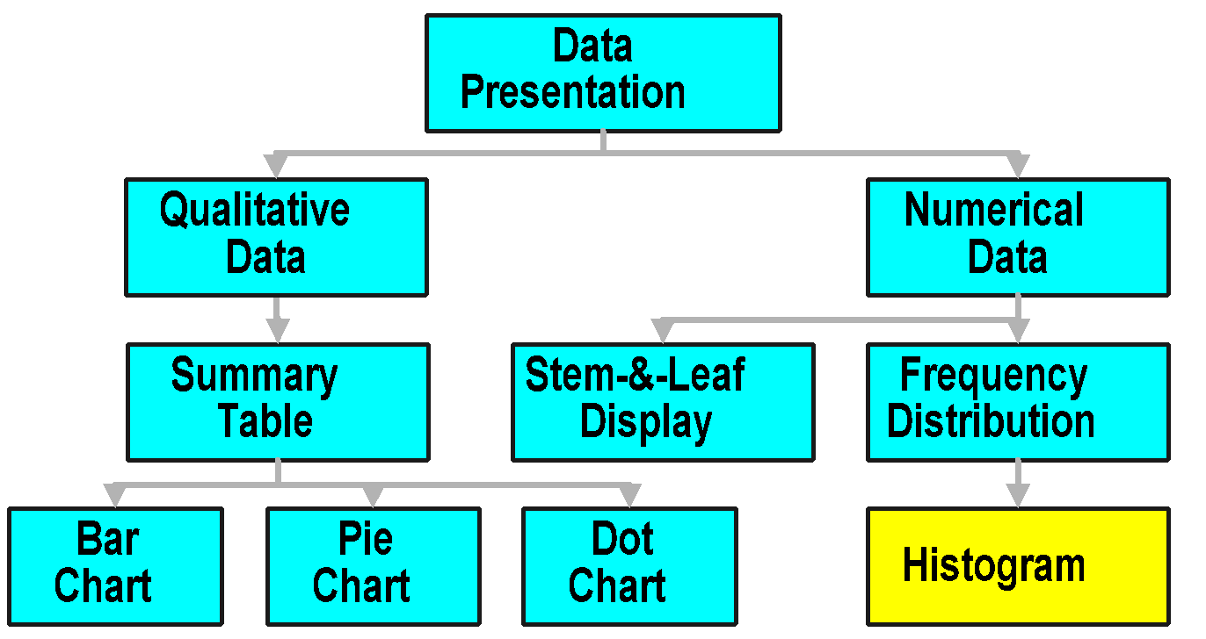
Data Presentation

Slide 29
Histogram
Class
Freq.
Count
15 but < 25
3
5
25 but < 35
5
35 but < 45
2
Frequency
Relative Frequency
Percent
4
3
2
Bars Touch
1
0
0 15 25 35 45 55
Lower Boundary

Slide 30
Numerical Data Properties

Slide 31
Thinking Challenge
$400,000
$70,000
$50,000
... employees cite low pay -- most workers earn only $20,000.
... President claims average pay is $70,000!
$30,000
$20,000
Notes:
11 total employees; total salaries are $770,000.
The mode is $20,000 (Union argument).
The median is $30,000.
The mean is $70,000 (President’s argument).
Different measures are used!

Slide 32
Standard Notation
Measure
Sample
Population
Mean

μ
X
Stand. Dev.
S
σ
Variance
2
2
S
σ
Size
n
N
Notes:
Throughout this chapter, we will be using the following notation, which I will introduce now.

Slide 33
Numerical Data Properties
Central Tendency (Location)
Variation (Dispersion)
Shape
Notes:
Location (Position)
Concerned with where values are concentrated.
Variation (Dispersion)
Concerned with the extent to which values vary.
Shape
Concerned with extent to which values are symmetrically distributed.

Slide 34
Numerical Data Properties & Measures
Numerical Data
Properties
Central
Variation
Shape
Tendency
Mean
Range
Skew
Median
Interquartile Range
Mode
Variance
Standard Deviation

Slide 35
Central Tendency

Slide 36
Numerical Data Properties & Measures
Numerical Data
Properties
Central
Variation
Shape
Tendency
Mean
Range
Skew
Median
Interquartile Range
Mode
Variance
Standard Deviation

Slide 37
Mean
1. Measure of Central Tendency
2. Most Common Measure
3. Acts as ‘Balance Point’
4. Affected by Extreme Values (‘Outliers’)
5. Formula (Sample Mean)
n
∑
X
i
X
+
X
+
☹
+
X
i
1
2
n
=
X
=
1
=
n
n

Slide 38
Mean Example
Raw Data: 10.3 4.9 8.9 11.7 6.3 7.7
n
∑
X
i
X
+
X
+
X
+
X
+
X
+
X
i
1
2
3
4
5
6
=
X
=
1
=
n
6
10
.
3
+
4
.
9
+
8
.
9
+
11
.
7
+
6
.
3
+
7
.
7
=
6
=
8
.
30

Slide 39
Numerical Data Properties & Measures
Numerical Data
Properties
Central
Variation
Shape
Tendency
Mean
Range
Skew
Median
Interquartile Range
Mode
Variance
Standard Deviation

Slide 40
Median
1. Measure of Central Tendency
2. Middle Value In Ordered Sequence
If Odd n, Middle Value of Sequence
If Even n, Average of 2 Middle Values
3. Position of Median in Sequence
4. Not Affected by Extreme Values
n
+
1
Positionin
g Point
=
2

Slide 41
Median Example Odd-Sized Sample
Raw Data: 24.1 22.6 21.5 23.7 22.6
Ordered: 21.5 22.6 22.6 23.7 24.1
Position: 1 2 3 4 5
n
+
1
5
+
1
Positionin
g Point
=
=
=
3
.
0
2
2
Median
=
22
.
6

Slide 42
Median Example Even-Sized Sample
Raw Data: 10.3 4.9 8.9 11.7 6.3 7.7
Ordered: 4.9 6.3 7.7 8.9 10.3 11.7
Position: 1 2 3 4 5 6
n
+
1
6
+
1
Positionin
g Point
=
=
=
3
.
5
2
2
7
.
7
+
8
.
9
Median
=
=
8
.
30
2

Slide 43
Numerical Data Properties & Measures
Numerical Data
Properties
Central
Variation
Shape
Tendency
Mean
Range
Skew
Median
Interquartile Range
Mode
Variance
Standard Deviation

Slide 44
Mode
1. Measure of Central Tendency
2. Value That Occurs Most Often
3. Not Affected by Extreme Values
4. May Be No Mode or Several Modes
5. May Be Used for Numerical & Categorical Data

Slide 45
Mode Example
No Mode Raw Data: 10.3 4.9 8.9 11.7 6.3 7.7
One Mode Raw Data: 6.3 4.9 8.9 6.3 4.9 4.9
More Than 1 Mode Raw Data: 21 28 28 41 43 43

Slide 46
Thinking Challenge
You’re a financial analyst for Prudential-Bache Securities. You have collected the following closing stock prices of new stock issues: 17, 16, 21, 18, 13, 16, 12, 11.
Describe the stock prices in terms of central tendency.
Notes:
This is the data from problem 3.54 in BL5ed.
Give the class 10-15 minutes to compute before showing the answer.

Slide 47
Central Tendency Solution*
Mean
n
∑
X
i
X
+
X
+
☹
+
X
i
1
2
8
=
X
=
1
=
n
8
17
+
16
+
21
+
18
+
13
+
16
+
12
+
11
=
8
=
15
.
5

Slide 48
Central Tendency Solution*
Median
Raw Data: 17 16 21 18 13 16 12 11
Ordered: 11 12 13 16 16 17 18 21
Position: 1 2 3 4 5 6 7 8
n
+
1
8
+
1
Positionin
g Point
=
=
=
4
.
5
2
2
16
+
16
Median
=
=
16
2
Notes:
Median = 6.5
Position = (n+1)/2 = (10+1)/2 = 5.5
1 2 3 5 6 7 8 8 9 11
1 2 3 4 5 6 7 8 9 10 (n = 10)
(6+7)/2 = 6.5

Slide 49
Central Tendency Solution*
Mode
Raw Data: 17 16 21 18 13 16 12 11
Ordered: 11 12 13 16 16 17 18 21
Notes:
Mode = 8
Midrange = 6
(X_{smallest} + X_{largest})/2 = (1+11)/2 = 6

Slide 50
Summary of Central Tendency Measures
Measure
Equation
Description
Mean
Σ
X
/
n
Balance Point
i
Median
(
n
+1)
Position
Middle Value
2
When Ordered
Mode
none
Most Frequent

Slide 51
Variation

Slide 52
Numerical Data Properties & Measures
Numerical Data
Properties
Central
Variation
Shape
Tendency
Mean
Range
Skew
Median
Interquartile Range
Mode
Variance
Standard Deviation

Slide 53
Range
1. Measure of Dispersion
2. Difference Between Largest & Smallest Observations
3. Ignores How Data Are Distributed
Range
=
X
−
X
l
arg
est
smallest
7
8
9
10
7
8
9
10

Slide 54
Numerical Data Properties & Measures
Numerical Data
Properties
Central
Variation
Shape
Tendency
Mean
Range
Skew
Median
Interquartile Range
Mode
Variance
Standard Deviation

Slide 55
Variance & Standard Deviation
1. Measures of Dispersion
2. Most Common Measures
3. Consider How Data Are Distributed
4. Show Variation About Mean (X or μ)

X
= 8.3
4
6
8
10
12

Slide 56
Sample Variance Formula
n
c
h
∑
2
n - 1 in denominator! (Use N if Population Variance)
X
−
X
i
2
i
=
S
=
1
n
−
1
c
h
c
h
c
h
2
2
2
X
−
X
+
X
−
X
+
☹
+
X
−
X
=
1
2
n
n
−
1

Slide 57
Sample Standard Deviation Formula
S
=
2
S
n
c
h
∑
2
X
−
X
i
i
=
=
1
n
−
1
c
h
c
h
c
h
2
2
2
X
−
X
+
X
−
X
+
☹
+
X
−
X
=
1
2
n
n
−
1

Slide 58
Variance Example
Raw Data: 10.3 4.9 8.9 11.7 6.3 7.7
n
c
h
n
∑
2
∑
X
−
X
X
i
i
2
i
=
1
i
=
S
=
where
X
=
1
=
8
.
3
n
−
1
n
a
f
a
f
a
f
10
2
2
2
.
3
−
8
.
3
+
4
.
9
−
8
.
3
+
☹
+
7
.
7
−
8
.
3
S
2
=
6
−
1
=
6
.
368

Slide 59
Thinking Challenge
You’re a financial analyst for Prudential-Bache Securities. You have collected the following closing stock prices of new stock issues: 17, 16, 21, 18, 13, 16, 12, 11.
What are the variance and standard deviation of the stock prices?
Notes:
This is the data from problem 3.54 in BL5ed.
Give the class 10-15 minutes to compute before showing the answer.

Slide 60
Variation Solution*
Sample Variance
Raw Data: 17 16 21 18 13 16 12 11
n
c
h
n
∑
2
∑
X
−
X
X
i
i
2
i
=
1
i
=
S
=
where
X
=
1
=
15
.
5
n
−
1
n
a
f
a
f
a
f
17
−
15
2
2
2
.
5
+
16
−
15
.
5
+
☹
+
11
−
15
.
5
2
S
=
8
−
1
=
11
.
14
Notes:
Using exact values:
Midhinge = (Q₁ + Q₃)/2 = (2.75 + 8.25)/2 = 11/2 = 5.5

Slide 61
Variation Solution*
Sample Standard Deviation
n
c
h
∑
2
X
−
X
i
2
i
=
S
=
S
=
1
=
11
.
14
=
3
.
34
n
−
1
Notes:
Using exact values:
Midhinge = (Q₁ + Q₃)/2 = (2.75 + 8.25)/2 = 11/2 = 5.5

Slide 62
Summary of Variation Measures
Measure
Equation
Description
Range
X
-
X
Total Spread
largest
smallest
Interquartile Range
Q
-
Q
Spread of Middle 50%
3
1
Standard Deviation
∑
(
2
Dispersion about
X
−
X
)
(Sample)
i
Sample Mean
n
−
1
Standard Deviation
∑
(
2
Dispersion about
X
−
μ
)
(Population)
i
X
Population Mean
N
Variance
Σ
(
2
Squared Dispersion
X
-
X
)
i

(Sample)
n
about Sample Mean
- 1

Slide 63
Shape

Slide 64
Numerical Data Properties & Measures
Numerical Data
Properties
Central
Variation
Shape
Tendency
Mean
Range
Skew
Median
Interquartile Range
Mode
Variance
Standard Deviation

Slide 65
Shape
1. Describes How Data Are Distributed
2. Measures of Shape
Skew = Symmetry
Left-Skewed
Symmetric
Right-Skewed
Mean
Median
Mode
Mean
=
Median
=
Mode
Mode
Median
Mean
Notes:
Shape
Concerned with extent to which values are symmetrically distributed.
Kurtosis
The extent to which a distribution is peaked (flatter or taller).
For example, a distribution could be more peaked than a normal distribution (still may be ‘bell-shaped). If values are negative, then distribution is less peaked than a normal distribution.
Skew
The extent to which a distribution is symmetric or has a tail. Values are 0 if normal distribution. If the values are negative, then negative or left-skewed.

Slide 66
Quartiles & Box Plots

Slide 67
Quartiles
1. Measure of Noncentral Tendency
2. Split Ordered Data into 4 Quarters
3. Position of i-th Quartile
25%
25%
25%
25%
Q₁
Q₂
Q₃
i
⋅
n
+
1
Positionin
g Point of
Q
=
i
4

Slide 68
Quartile (Q₁) Example
Raw Data: 10.3 4.9 8.9 11.7 6.3 7.7
Ordered: 4.9 6.3 7.7 8.9 10.3 11.7
Position: 1 2 3 4 5 6
1
⋅
n
+
1
1
⋅
6
+
1
Q
Position
=
=
=
1
.
75
≅
2
1
4
4
Q
=
6
.
3
1

Slide 69
Quartile (Q₂) Example
Raw Data: 10.3 4.9 8.9 11.7 6.3 7.7
Ordered: 4.9 6.3 7.7 8.9 10.3 11.7
Position: 1 2 3 4 5 6
a
f
a
f
2
⋅
n
+
1
2
⋅
6
+
1
Q
Position
=
=
=
3
.
5
2
4
4
7
.
7
+
8
.
9
Q
=
=
8
.
3
2
2

Slide 70
Quartile (Q₃) Example
Raw Data: 10.3 4.9 8.9 11.7 6.3 7.7
Ordered: 4.9 6.3 7.7 8.9 10.3 11.7
Position: 1 2 3 4 5 6
a
f
a
f
3
⋅
n
+
1
3
⋅
6
+
1
Q
Position
=
=
=
5
.
25
≅
5
3
4
4
Q
=
10
.
3
3

Slide 71
Numerical Data Properties & Measures
Numerical Data
Properties
Central
Variation
Shape
Tendency
Mean
Range
Skew
Median
Interquartile Range
Mode
Variance
Standard Deviation

Slide 72
Interquartile Range
1. Measure of Dispersion
2. Also Called Midspread
3. Difference Between Third & First Quartiles
4. Spread in Middle 50%
5. Not Affected by Extreme Values
Interquart
ile Range
=
Q
−
Q
3
1

Slide 73
Thinking Challenge
You’re a financial analyst for Prudential-Bache Securities. You have collected the following closing stock prices of new stock issues: 17, 16, 21, 18, 13, 16, 12, 11.
What are the quartiles, Q₁ and Q_{3,} and the interquartile range?
Notes:
This is the data from problem 3.54 in BL5ed.
Give the class 10-15 minutes to compute before showing the answer.

Slide 74
Quartile Solution*
Q₁
Raw Data: 17 16 21 18 13 16 12 11
Ordered: 11 12 13 16 16 17 18 21
Position: 1 2 3 4 5 6 7 8
a
f
a
f
1
⋅
n
+
1
1
⋅
8
+
1
Q
Position
=
=
=
2
.
5
1
4
4
Q
=
12
.
5
1
Notes:
Q₁ = 1(n+1)/4 = 1(10+1)/4 = 11/4 = 2.75 Position
If exact values:
75% of way Between 2 & 3; Value is 2.75

Slide 75
Quartile Solution*
Q₃
Raw Data: 17 16 21 18 13 16 12 11
Ordered: 11 12 13 16 16 17 18 21
Position: 1 2 3 4 5 6 7 8
a
f
a
f
3
⋅
n
+
1
3
⋅
8
+
1
Q
Position
=
=
=
6
.
75
≅
7
3
4
4
Q
=
18
3
Notes:
Q₃ = 3(n+1)/4 = 3(10+1)/4 = 33/4 = 8.25 Position
If exact values:
25% of way Between 8 & 9; Value is 8.25

Slide 76
Interquartile Range Solution*
Interquartile Range
Raw Data: 17 16 21 18 13 16 12 11
Ordered: 11 12 13 16 16 17 18 21
Position: 1 2 3 4 5 6 7 8
Interquart
ile Range
=
Q
−
Q
=
18
.
0
−
12
.
5
=
5
.
5
3
1
Notes:
Using exact values:
Midhinge = (Q₁ + Q₃)/2 = (2.75 + 8.25)/2 = 11/2 = 5.5

Slide 77
Box Plot
1. Graphical Display of Data Using 5-Number Summary
X
Q
Median
Q
X
smallest
1
3
largest
4
6
8
10
12

Slide 78
Shape & Box Plot
Left-Skewed
Symmetric
Right-Skewed
Q
Median
Q
Q
Median
Q
Q
Median
Q
1
3
1
3
1
3

Slide 79
Distorting the Truth with Descriptive Techniques

Slide 80
Errors in Presenting Data
1. Using ‘Chart Junk’
2. No Relative Basis in Comparing Data Batches
3. Compressing the Vertical Axis
4. No Zero Point on the Vertical Axis

Slide 81
‘Chart Junk’
Bad Presentation
Good Presentation
Minimum Wage
Minimum Wage
$
1960: $1.00
4
1970: $1.60
2
1980: $3.10
0
1990: $3.80
1960
1970
1980
1990

Slide 82
No Relative Basis
Bad Presentation
Good Presentation
A’s by Class
A’s by Class
Freq.
%
300
30%
200
20%
100
10%
0
0%
FR
SO
JR
SR
FR
SO
JR
SR

Slide 83
Compressing Vertical Axis
Bad Presentation
Good Presentation
Quarterly Sales
Quarterly Sales
$
$
200
50
100
25
0
0
Q1
Q2
Q3
Q4
Q1
Q2
Q3
Q4

Slide 84
No Zero Point on Vertical Axis
Bad Presentation
Good Presentation
Monthly Sales
Monthly Sales
$
$
45
60
42
40
39
20
36
0
J
M
M
J
S
N
J
M
M
J
S
N

Slide 85
Conclusion
1. Described Qualitative Data Graphically
2. Described Numerical Data Graphically
3. Created & Interpreted Graphical Displays
4. Explained Numerical Data Properties
5. Described Summary Measures
6. Analyzed Numerical Data Using Summary Measures

Slide 86
End of Chapter
Any blank slides that follow are blank intentionally.

